Slide 1
Evolutionary Computation
an introduction to evolutionary algorithms

Slide 2

Who am I?
Dr. Shahin Rostami
Lecturer in Computational Intelligence
at the Bournemouth University
Ph.D. thesis:
“Preference Focussed Many-Objective Evolutionary Computation”

Slide 3
Presentation overview
Why Evolutionary Computation?
What is it?
How does it work?
Further reading

Slide 4
Why?
What?
How?
Next?
Why Evolutionary Computation?
Exciting applications in many fields:
▫ Concealed weapon detection
▫ Medical scan classifiers
▫ Automotive active steering controllers
▫ SMART home systems
▫ A.I. behaviour for video games

Slide 5

Why?
What?
How?
Next?
Why Evolutionary Computation?
Improve design of systems
Make an impact on safety of others

Slide 6
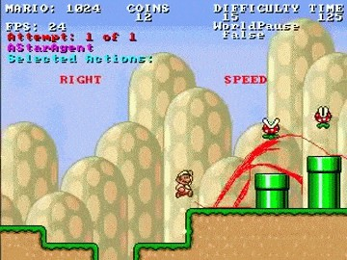
Why?
What?
How?
Next?
Why Evolutionary Computation
Design A.I. behaviour with preference towards:
▫ Fast level completion
▫ Aggressiveness
▫ Score achievement
▫ Coins collected
▫ Or a compromise of the above

Slide 7
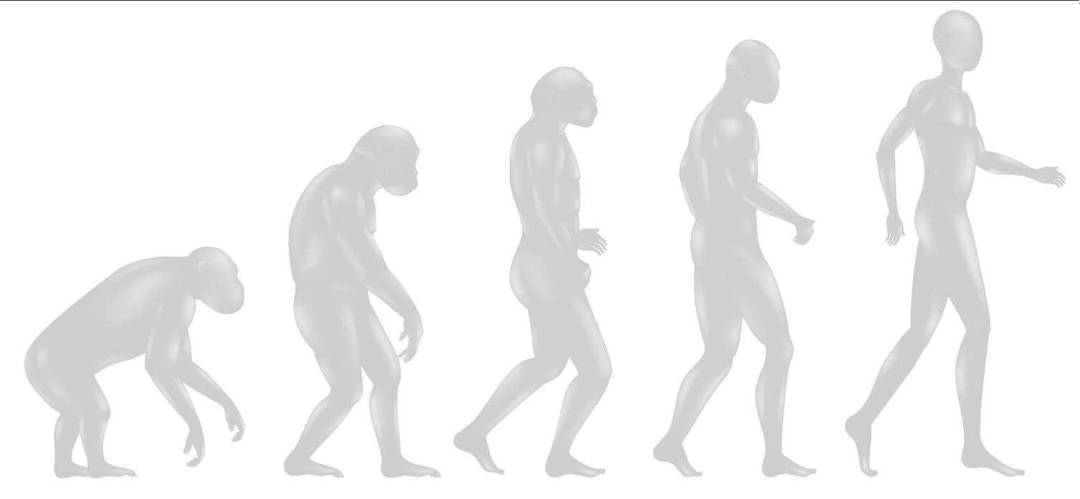
Why?
What?
How?
Next?
What is Evolutionary Computation?
A nature inspired approach to optimisation
Process of getting the most out of something
Inspired by the notion of survival of the fittest from Darwinian Evolution and modern genetics

Slide 8
Why?
What?
How?
Next?
How does it work?
 | Initialisation
 | Evaluate
 | Terminate?
 | Selection
 | Variation

Slide 9

Why?
What?
How?
Next?
How does it work?
 | Initialisation
 | Evaluate
[A] [B] [C] [D] [E] [F]
 | Terminate?
 | Selection
 | Variation

Slide 10
Why?
What?
How?
Next?
How does it work?
 | Initialisation
 | Evaluate
[A] [B] [C] [D]
[E] [F]
 | Terminate?
Left arm length
Right arm length
Head Size
Parameters:
Left leg length
Right leg length
Torso length
 | Selection
 | Variation
Chromosome:
Left Leg | Torso | Left Arm | Head | Right Arm | Right Leg

Slide 11

Why?
What?
How?
Next?
How does it work?
 | Initialisation
 | Evaluate
[A] [B] [C] [D] [E] [F]
 | Terminate?
 | Selection
 | Variation
0
100
200
300
400
500
600

Slide 12
Why?
What?
How?
Next?
How does it work?
 | Initialisation
 | Evaluate
[A] [B] [C] [D] [E] [F]
 | Terminate?
 | Selection
 | Variation
0
100
200
300
400
500
600

Slide 13
Why?
What?
How?
Next?
How does it work?
 | Initialisation
 | Evaluate
[A] [B] [C] [D] [E] [F]
250
 | Terminate?
 | Selection
 | Variation
0
100
200
300
400
500
600

Slide 14

Why?
What?
How?
Next?
How does it work?
 | Initialisation
 | Evaluate
[A] [B] [C] [D] [E] [F]
250
 | Terminate?
 | Selection
 | Variation
0
100
200
300
400
500
600

Slide 15

Why?
What?
How?
Next?
How does it work?
 | Initialisation
 | Evaluate
[A] [B] [C] [D] [E] [F]
250 350
 | Terminate?
 | Selection
 | Variation
0
100
200
300
400
500
600

Slide 16
Why?
What?
How?
Next?
How does it work?
 | Initialisation
 | Evaluate
[A] [B] [C] [D] [E] [F]
250 350
 | Terminate?
 | Selection
 | Variation
0
100
200
300
400
500
600

Slide 17
Why?
What?
How?
Next?
How does it work?
 | Initialisation
 | Evaluate
[A] [B] [C] [D] [E] [F]
250 350 240
 | Terminate?
 | Selection
 | Variation
0
100
200
300
400
500
600

Slide 18
Why?
What?
How?
Next?
How does it work?
 | Initialisation
 | Evaluate
[A] [B] [C] [D] [E] [F]
250 350 240
 | Terminate?
 | Selection
 | Variation
0
100
200
300
400
500
600

Slide 19
Why?
What?
How?
Next?
How does it work?
 | Initialisation
 | Evaluate
[A] [B] [C] [D] [E] [F]
250 350 240 320
 | Terminate?
 | Selection
 | Variation
0
100
200
300
400
500
600

Slide 20
Why?
What?
How?
Next?
How does it work?
 | Initialisation
 | Evaluate
[A] [B] [C] [D] [E] [F]
250 350 240 320
 | Terminate?
 | Selection
 | Variation
0
100
200
300
400
500
600

Slide 21

Why?
What?
How?
Next?
How does it work?
 | Initialisation
 | Evaluate
[A] [B] [C] [D] [E] [F]
250 350 240 320 10
 | Terminate?
 | Selection
 | Variation
0
100
200
300
400
500
600

Slide 22
Why?
What?
How?
Next?
How does it work?
 | Initialisation
 | Evaluate
[A] [B] [C] [D] [E] [F]
250 350 240 320 10
 | Terminate?
 | Selection
 | Variation
0
100
200
300
400
500
600

Slide 23
Why?
What?
How?
Next?
How does it work?
 | Initialisation
 | Evaluate
[A] [B] [C] [D] [E] [F]
250 350 240 320 10 0
 | Terminate?
 | Selection
 | Variation
0
100
200
300
400
500
600

Slide 24
Why?
What?
How?
Next?
How does it work?
 | Initialisation
 | Evaluate
[A] [B] [C] [D] [E] [F]
250 350 240 320 10 0
 | Terminate?
Termination Criteria
Goal achieved?
Number of generations reached max?
Performance stagnating?
 | Selection
 | Variation

Slide 25
Why?
What?
How?
Next?
How does it work?
 | Initialisation
 | Evaluate
[A] [B] [C] [D] [E] [F]
250 350 240 320 10 0
 | Terminate?
 | Selection
 | Variation

Slide 26
Why?
What?
How?
Next?
How does it work?
 | Initialisation
 | Evaluate
[A] [B] [C] [D] [E] [F]
250 350 240 320 10 0
 | Terminate?
 | Selection
 | Variation

Slide 27
Why?
What?
How?
Next?
How does it work?
 | Initialisation
 | Evaluate
[A] [B] [C]
250 350 320
 | Terminate?
 | Selection
 | Variation

Slide 28
Why?
What?
How?
Next?
How does it work?
 | Initialisation
 | Evaluate
[A] [B] [C]
250 350 320
 | Terminate?
 | Selection
 | Variation
Left Leg | Torso | Left Arm | Head | Right Arm | Right Leg

Slide 29
Why?
What?
How?
Next?
How does it work?
 | Initialisation
 | Evaluate
[A] [B] [C]
250 350 320
[D]
 | Terminate?
 | Selection
 | Variation
Left Leg | Torso | Left Arm | Head | Right Arm | Right Leg

Slide 30


Why?
What?
How?
Next?
How does it work?
 | Initialisation
 | Evaluate
[A] [B] [C]
250 350 320
[D] [E]
 | Terminate?
 | Selection
 | Variation
Left Leg | Torso | Left Arm | Head | Right Arm | Right Leg

Slide 31


Why?
What?
How?
Next?
How does it work?
 | Initialisation
15
secs
 | Evaluate
[A] [B] [C]
250 350 320
[D] [E] [F]
 | Terminate?
 | Selection
 | Variation
Left Leg | Torso | Left Arm | Head | Right Arm | Right Leg

Slide 32
Why?
What?
How?
Next?
How does it work?
 | Initialisation
15
secs
 | Evaluate
[A] [B] [C]
250 350 320
[D] [E] [F]
 | Terminate?
 | Selection
 | Variation
Left Leg | Torso | Left Arm | Head | Right Arm | Right Leg

Slide 33

Why?
What?
How?
Next?
How does it work?
 | Initialisation
 | Evaluate
[A] [B] [C]
250 350 320
[D] [E] [F]
 | Terminate?
 | Selection
 | Variation
Left Leg | Torso | Left Arm | Head | Right Arm | Right Leg

Slide 34

Why?
What?
How?
Next?
How does it work?
 | Initialisation
 | Evaluate
[A] [B] [C]
250 350 320
[D] [E] [F]
 | Terminate?
 | Selection
 | Variation
Left Leg | Torso | Left Arm | Head | Right Arm | Right Leg

Slide 35



Why?
What?
How?
Next?
How does it work?
 | Generation 1
 | Generation 2

Slide 36
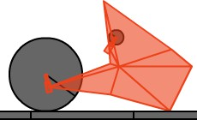
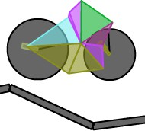

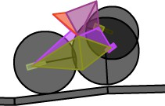
Why?
What?
How?
Next?
Further playing
Visit: http://boxcar2d.com/
Evolutionary Computation used to design a vehicle within the
Box2D Physics engine.

Slide 37
Why?
What?
How?
Next?
Further reading
▫ Genetic Algorithms in Search, Optimization and Machine Learning [Book] ISBN: 0201157675
▫ Transactions on Evolutionary Computation, [Journal], IEEE
http://ieeexplore.ieee.org/xpl/RecentIssue.jsp?punumber=4235
▫ Evolutionary Computation [Journal], MIT
http://www.mitpressjournals.org/loi/evco
▫ Swarm and Evolutionary Computation [Journal], Elsevier
http://www.journals.elsevier.com/swarm-and-evolutionary-computation
▫ My publications at www.shahinrostami.com

Slide 38
Presentation overview
Why Evolutionary Computation?
What is it?
How does it work?
Further reading

Slide 39

Thank you, any questions?
Dr. Shahin Rostami Bournemouth University srostami@bournemouth.ac.uk @shahinrostami github.com/shahinrostami www.shahinrostami.com

